Slide 1
COURNOT MODEL
Applied Economics
Dhanashri Kanitkar
Hrishita Bapuram
Shraddha Kodavade

Slide 2
TABLE OF CONTENTS
01
02
Model Idea and Origin
Model in Charts - Simulation

Slide 3
01
Cournot Model
THE THEORY

Slide 4
What is Cournot model?
Cournot competition is an economic model used to describe an industry structure in which companies compete on the amount of output they will produce, which they decide on independently of each other and at the same time.
It is named after Antoine Augustin Cournot (1801–1877) who was inspired by observing competition in a spring water duopoly.

Slide 5

Features of Cournot Model
There is more than one firm and all firms produce a homogeneous product.
Firms do not cooperate so there is no collision.
Firms have market power. So each firm's output decision affects the good's price.
The number of firms producing are fixed.
The firms are usually seeking to maximize profit given their competitors' decisions.

Slide 6
Assumptions
Cournot duopoly assumed that there are two firms. Thus it is a duopoly model.
Cournot also assumed that there are two firms each owning a mineral well, and operating with zero costs. Thus this model applies to identical product and identical cost conditions.
He also assumed that each firm acts on the perception that its competitor will not change its output, and decides its own output so as to maximize profit.

Slide 7
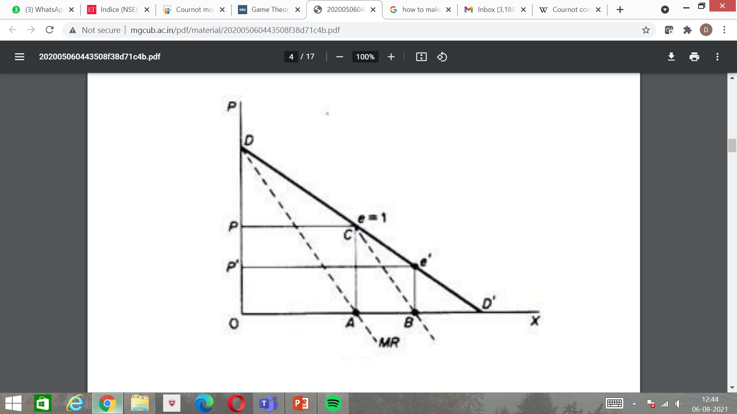
Firm A: The Beginner
Assume that firm A is the first to start producing and selling mineral water. It will produce quantity A, at price P where profits are at a maximum, because at this point MC — MR = 0.
The elasticity of market demand at this level of output is equal to unity and the total revenue of the firm is a maximum. With zero costs, maximum total revenue implies maximum profits.
Now firm B assumes that A will keep its output fixed, and hence considers that its own demand curve is CD’.

Slide 8
Firm B: The New Entrant
Clearly firm B will produce half the quantity AD’, because (under the Cournot assumption of fixed output of the rival) at this level (AB) of output (and at price F) its revenue and profit is at a maximum.
B produces half of the market which has not been supplied by A, that is, B’s output is ¼ of the total market.

Slide 9
The Reaction Pattern of Firms
While deciding his own output in reaction to it’s competitors output, each firm will be guided by the following formula.
One Firm’s Output = ½ (Total Market Demand – Present Output of the Other Firm)
At the time of entry output of Firm-A is: ½ (OD’ – 0) = ½ OD’ = OA.
Following OA output of Firm-A, output of Firm-B is :
½ (OD’ – ½ OD’) = ½ OD’ – ¼ OD’ = ¼ OD’ =AB
Firm-A will react to this by producing the following level output
½ (OD’ – ¼ OD’) = ½ OD’ – 1/8 OD’ = 3/8 OD’

Slide 10

Final Outcome
This action-reaction pattern continues, since firms have the naive behaviour of never learning from past patterns of reaction of their rival.
However, eventually an equilibrium will be reached in which each firm produces one-third of the total market. Together they cover two-thirds of the total market.
Each firm maximises its profit in each period, but the industry profits are not maximised.

Slide 11
Equilibrium Output
When Firm-A produces 1/3 OD’ the Firm-B will be in equilibrium by producing the same level of output.
Firm-B’s Output = ½ (OD’ – 1/3 OD’) = ½ OD’ – 1/6 OD’ = 1/3 OD’.
Firm-A’s Output = ½ (OD’ – 1/3 OD’) = ½ OD’ – 1/6 OD’ = 1/3 OD’.
Thus both will be in equilibrium by producing one third of output and total output will be two-third of the total market demand.

Slide 12
Number of Firms & Output
When there are two firms total output produced is 2/3 of total market demand.
In general, if there are n firms in the industry each will provide 1 /(n + 1) of the market, and the industry output will be n/(n + 1) = 1 /(n + 1)*n.
Clearly as more firms are assumed to exist in the industry, the higher the total quantity supplied and hence the lower the price.
The larger the number of firms the closer is output and price to the competitive level.

Slide 13
02
Cournot Model
A SIMULATION

Slide 14

The Spring Water Duopoly
The earliest duopoly model was developed in 1838 by the French economist Augustin Cournot.
The original version is quite limited in that it makes the assumption that the duopolies have identical products and identical costs.
Actually Cournot illustrated his model with the example of two firms each owning a spring of mineral water, which is produced at zero costs.
Cournot assumed that there are two firms each owning a mineral well, and operating with zero costs. They sell their output in a market with a straight-line demand curve.
Each firm acts on the assumption that its competitor will not change its output, and decides its own output so as to maximize profit. Assume that firm A is the first to start producing and selling mineral water. It will produce quantity A, at price P where profits are at a maximum

Slide 15
ASSUMPTIONS
The market structure is a Duopoly
The price and demand of the product are equally proportional
All other factors affecting market demand (except the competing firm) and all other factors affecting market price (other than the demand fluctuations) are assumed to be constant.

Slide 16
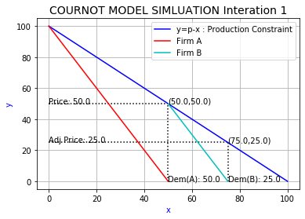

Slide 17
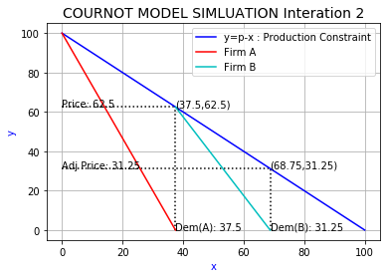

Slide 18
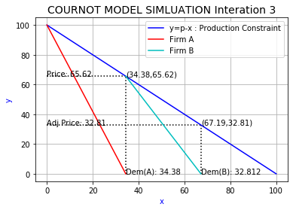

Slide 19
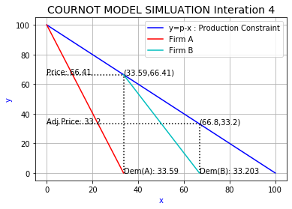

Slide 20


Slide 21
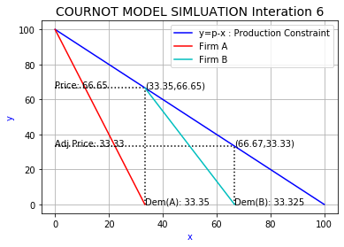

Slide 22


Slide 23


Slide 24
THANK YOU

